Slide 1
Test prioritization process
2020-08-20
JuHyoung Kim
kjhkjh75@naver.com

Slide 2
- Process
~ 8/24 : Organize TCP Table
~ 9/4 : Ideation
~ : plan experiment

Slide 3
- Paper list
Similarity-based
Fast Approaches to scalable similarity-based Test case prioritization
Scalable approaches for test suite reduction
Test case prioritization using test similarities
Similarity-based regression test case prioritization
A similarity-based approach for test case prioritization using historical failure data

Slide 4
- Paper list
2. Selection of techniques
Optimizing Test Prioritization via Test Distribution Analysis

Slide 5
- Paper list
3. Coverage based
Supervised Tie Breaking in Test case prioritization
QTEP : Quality-Aware Test Case Prioritization

Slide 6
- Paper list
4. Mutant – related research
Assessing Test Case prioritization on Real Faults and Mutants
Empirical evaluation of mutation-based test case prioritization techniques

Slide 7


- Primary concept
Evaluation metrics
Consider all test case as same coverage and severity.
Consider test case cost and severity

Slide 8
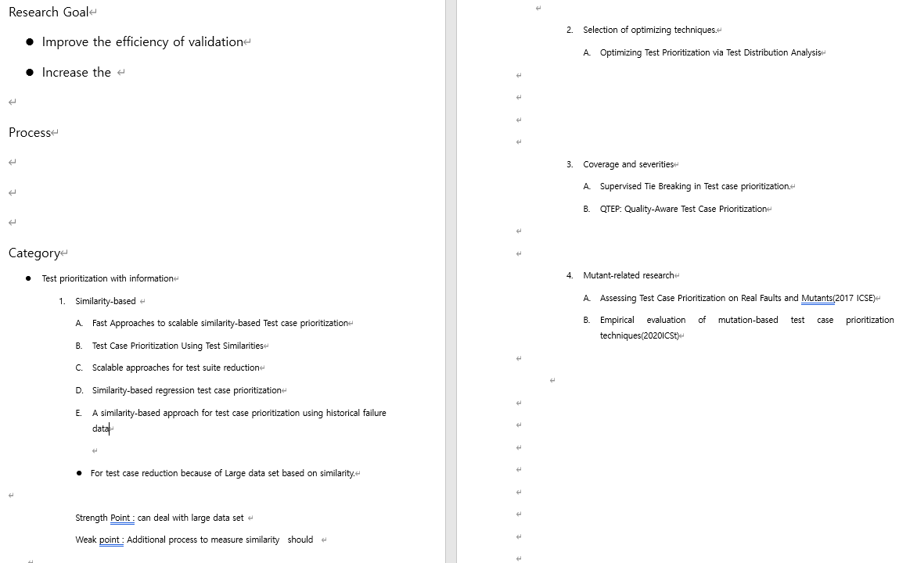
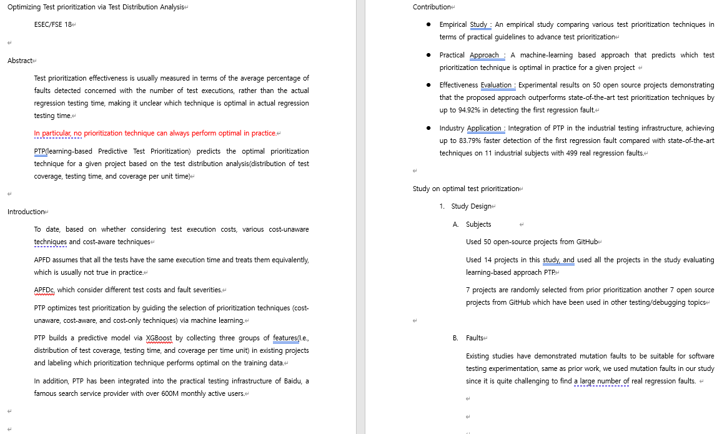
- Process

Slide 9
- Main Idea
Fast Approaches to Scalable Similarity-based Test Case prioritization
Objective : Give Priority to the test cases that are the most dissimilar from those already selected.
Approach : Measure the similarity of two sets A and B as their Jaccard similarity
Evaluation metric = APFD
And assess preparation time and prioritization time

Slide 10
- Main Idea
Scalable Approaches for Test suite Reduction.
Objective : Give Priority to the test cases that are the most dissimilar from those already selected.
Approach : Measure the similarity of two points is expressed by the Euclidean distance
Evaluation metric = Fault Detection Loss, Total Time(including preparation time)and time for doing only the reduction itself.

Slide 11
- Main Idea
Optimizing Test prioritization via Test Distribution Analysis
Objective : Behave the test suite reduction using bigdata technique
Approach : Builds predictive model via XGBoost by collecting features(test coverage, testing time, coverage per unit time distribution)
Evaluation metrics : APFD, APFDc

